Slide 1
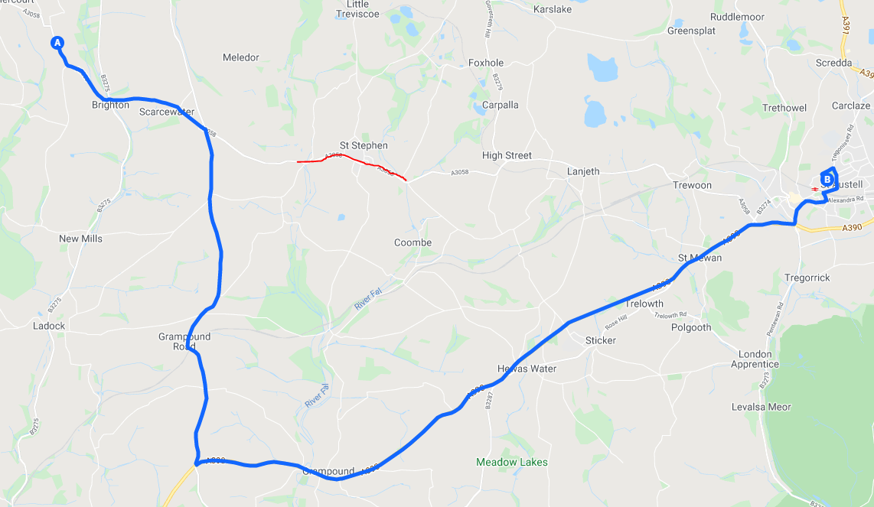

CUSTOMER NOTICE
Roadworks affecting the network
St Stephens Road closure service 29
On Friday 29th October 2021 7:30- 18:00
Bus service 29 will run from Brighton cross to Grampound Road then left onto the A390 into St Austell. From St Austell bus service 29 will head along the A390 to Grampound road then left to Brighton cross returning to normal route.
During this closure bus service 29 will be unable to serve St Stephens, Highstreet and Trewoon.
We apologise in advance for any disruption and inconvenience caused by these essential works. For further information please contact Go Cornwall Bus on 0808 196 2632

